Slide 1

Web scraping to gain company insights
3/4/2024

Slide 2
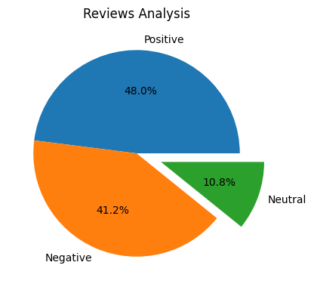
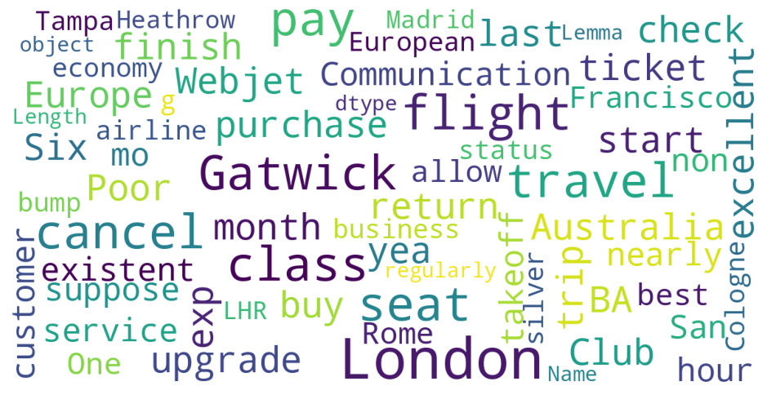
INSIGHTS FROM CUSTOMER REVIEWS
From cleaning 1000 reviews given by the customers, we obtained
Positive Reviews - 480
Negative Reviews - 412
Neutral Reviews – 108
Word cloud of keywords used in reviews

